Slide 1
WUCWO COVID-19 PRESENTATION
-Catherine Nyangulu-

Slide 2
Contents
Background Information
Activities Implemented at Diocese level
Activities Implemented at National level
Way Forward

Slide 3
Background Information
As identified in December, 2019, Covid-19, a local outbreak of respiratory infection culminated into a global pandemic.
Countries all over the world have experienced a rise in new cases ever since, exiting the first wave and experiencing the advent of the second wave.
As one Catholic church living in a common home, we have not been spared of the unexpected effects of this great pandemic.
Buying the model of Mother Mary as the resilient woman, Catholic Women Organization (CWO), Malawi have taken up the challenge in joining the government, the church and other organizations in strengthening preventive measures towards the fight against the pandemic.

Slide 4
Activities Implemented at Diocese Level
We have sensitized families to take care of the elderly in their families with love
Praying, visiting and donating various items to the sick in the hospitals
protecting children, the elderly and people with disabilities from various forms of abuse but also against being infected by the disease.
Lilongwe, Blantyre, Karonga and Zomba assisted diocesan priests with various assorted items such as soap, food stuffs, sugar, fruits, potatoes, hand washing facilities among others.

Slide 5
…continuation……
encouraging our fellow women to pray for those that have been infected by the disease
sending through messages of love, hope and light to those in isolation and quarantine reminding them that they are still a part of us and they are not alone.
Women have assisted with masks, sanitizers, oxygen cylinders and financial support within their dioceses

Slide 6
Activities Implemented at National level
At National level, CWO is implementing a project on Covid-19 response in two archdioceses of Blantyre and Lilongwe. The following are some of the interventions under this project;
Conducting radio programs to continue nourishing and enlightening our individuals with messages of faith, hope and love.
The program helped in seizing fear and demolishing myths surrounding the disease.
Conducting Masses on Radio Maria, praying for the sick, the deceased, those caring for sick people and the entire nation
Distributing hand washing soap, hand sanitizer, foot operating hand washing machine and washable masks.

Slide 7
…..Continuation…
Supporting evangelization through social media pages of “Tiyankhuleni Ambuye” and “ Word Made Flesh”.
Educating and awareness raising through dissemination of Information, Education and Communication (IEC) materials i.e. Posters
Community sensitization using Mobile vehicle Public Address System in communities within the catchment areas.

Slide 8
Way Forward
To help seminarians and Catholic students with washable masks, donate hand washing facilities, soap and sanitizer in the schools
Continued sensitization through social media, church structures, radio and IEC materials.
Enforcement of adherence to covid-19 preventive measures at all levels. c

Slide 9
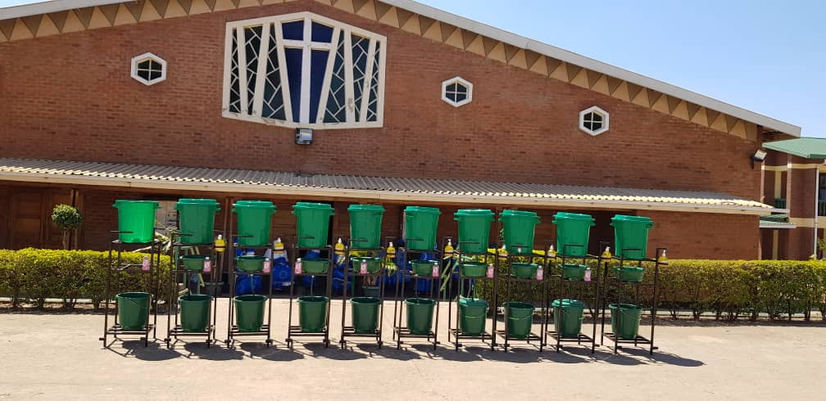
Pictures Showing Highlight of Activities.. i. Foot Operating Hand Washing Machines

Slide 10
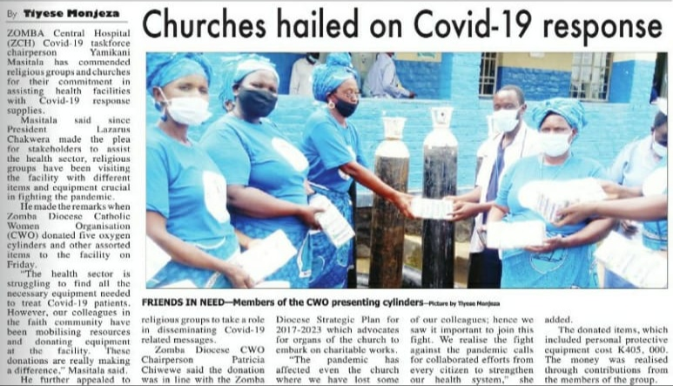
ii. Oxygen Cylinders Donated to Zomba Central
Hospital

Slide 11
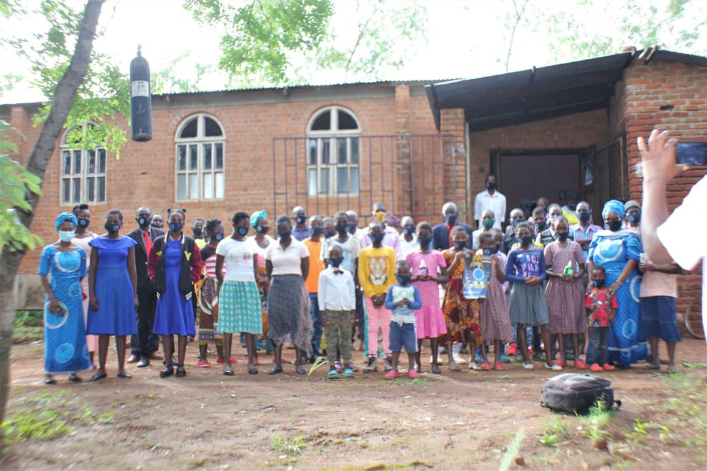
iii. Chinyama outchurch poses after receiving washable masks

Slide 12
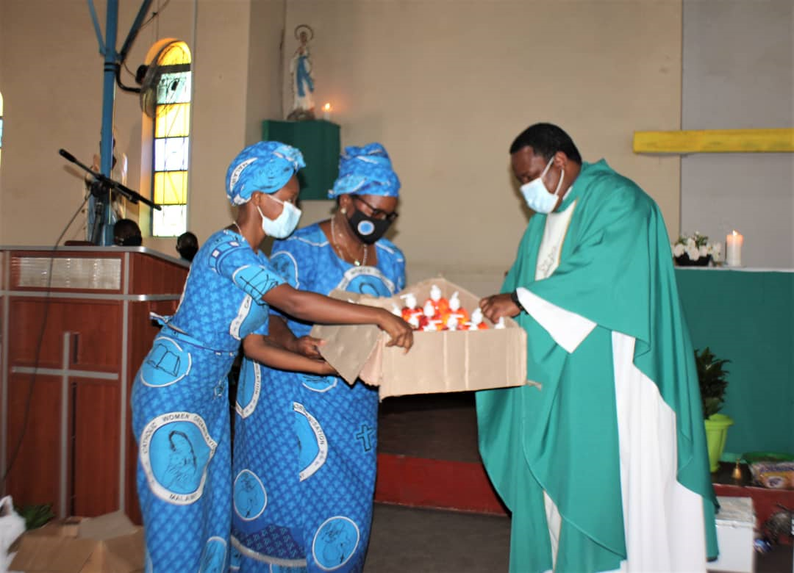
iv. CWO handing over Hand Washing Soap at St. Marys Parish

Slide 13
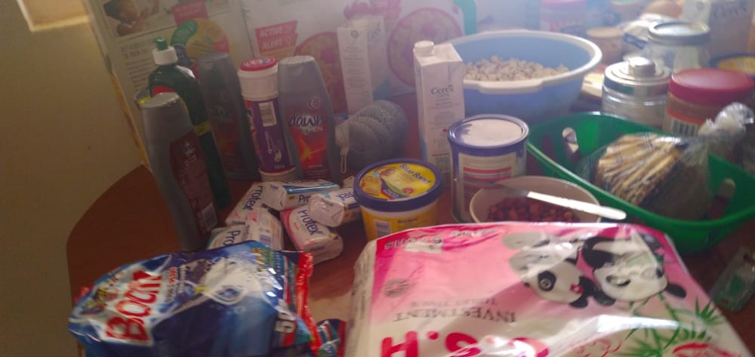
v. Donation of Various Food Stuffs

